Slide 1
C++ Programming Today 2nd Edition By Barbara Johnston Chapter 3
Instructor: <Instructor Name>
Lecture Slides by Kelly Montoya and Rob Garner

Slide 2
Chapter 3
Relational and Logical Operators
If statements
Ternary Operator
Switch Statements
Loop control structures
For Loops
While Loops
Do While Loops
Program flow control statements
Common Errors
Reading numbers and strings
Vector Class
Review
Random Number Generation

Slide 3
Relational and Logical Operators
Explain how to use relational and logical operators.

Slide 4
Relational and Logical Operators
A conditional statement is used to determine the relationship between variables and/or constants.
The result of the evaluation is a 1 (true) or a 0 (false).
Relational operators and logical operators typically work together, and are shown in the following tables, along with their uses and an example.

Slide 5
Relational Operators
Relational Operators

Slide 6
Write the code that will return true if float floatA is less than or equal to float floatB.

Slide 7
Write the code that will return true if integer intA is equal to integer intB.

Slide 8
Logical Operators

Slide 9
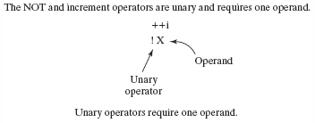
Relational and Logical Operators
The relational and logical operators (AND, &&, and OR, ||) are binary;
a binary operator expects two values or operands.
The NOT operator (!) is a unary operator;
a unary operator requires only a single operand.

Slide 10
Write the code that returns true if integer intA is greater than integer intB and string userInput is equal to “yes”.

Slide 11
Write the code that returns true if integer intA is greater than integer intB OR string userInput is equal to “yes”.

Slide 12
Write the code that returns true if string userInput is not equal to “ignore”.

Slide 13
Evaluating Expressions
Operations are performed in a prescribed order known as precedence of operations.
C++ knows what do to first, second, third, etc.
For example, multiply occurs before addition, relational before logical.
arithmetic *, /, %
arithmetic +, -
relational <, <=, >, >=
relational ==, !=
logical &&
logical ||
assign =

Slide 14
Precedence of Operators (partial list)

Slide 15
Relational and Logical Operators: Simple Examples

Slide 16
If Statements
Explain how to use an if statements.

Slide 17
if Statements
The if statement is based on a relational and/or logical expression which evaluates to true or false.
The general form of the if statement:
if(Condition)
{
//These statements are executed if //Condition is true or
//skipped if Condition is false.
}

Slide 18
if Statements
For example, if the gas tank level is less than 0.25, the condition is true, so the phrase “Get gasoline.” is written to the screen.

Slide 19
if Statements
The braces do not have to be on new lines.
The following format is also correct.
If there is only one statement to be executed, the braces are not required.
if(gasTank < 0.25){
cout << "\n Get gasoline.";
}
if(gasTank < 0.25)cout << "\n Get gasoline.";

Slide 20
if Statements
Or like this:
The braces are needed if more than one statement is to be executed, such as:
if(gasTank < 0.25)
cout << "\n Get gasoline.";
if(gasTank < 0.25)
{
cout << "\n Get gasoline.";
cout << "\n Wash your windows too."
}

Slide 21
if else Statements
Do something if the condition is true and something else if the condition is false.
General form of if else:
if(Condition)
{
//this done if Condition is true
}
else
{
//this done if Condition is false
}

Slide 22
If “number” is greater than 0, “The number is positive!” is written to the screen.
If it’s not , “The number is zero or negative!” is written to the screen.

Slide 23
Write an if then statement that will output “In range” if intA is >0 and <10.

Slide 24
if—else if—else Statements
The else if structure is a series of if/else if statements.
if(Condition1)
{
// Condition 1 statements
}
else if(Condition2)
{
// Condition 2 statements
}
else
{
// other statements
}

Slide 25
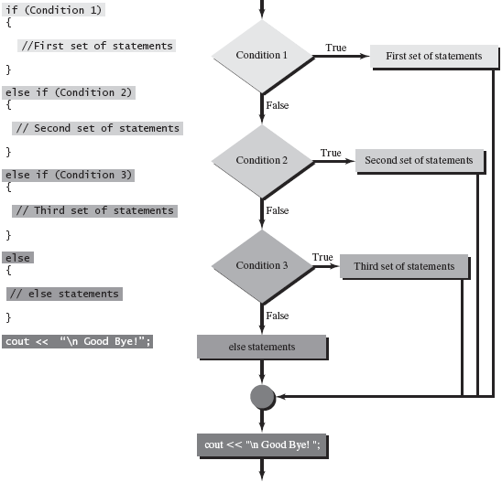
if—else if—else Statements

Slide 26
if—else if—else Statements
if(today == "Monday" || today == "Wednesday")
{
cout << "\n Go to C++ class.";
}
else if(today == "Tuesday" || today == "Thursday")
{
cout << "\n Go to math class.";
}
else
{
cout << "\n Do not go to school.";
}
The else block of code catches all the other days of the week,
so we do not need to write a statement that checks if the day
is Friday, Saturday or Sunday.

Slide 27
Troubleshooting: Using braces with if statements
It is strongly recommended that C++ programmers always use braces to enclose statements in their if/if else statements.
It is permissible not to use the braces when an if statement has a single statement.
For any compound if else or if else if format, always use the braces!

Slide 28
Inefficient Programming Techniques
Control falls into the else statements if none of the conditions are true.
Checking all the possible cases or checking each case individually makes extra work.
Using independent if statements is the most inefficient.
It guarantees that the program executes all if statements.
A set of if-else’s will do the same thing.
Notes:
See Program 3-1 for examples of if/else if/else.

Slide 29
Inefficient Programming Techniques
//This uses an extra "else if" statement.
if(number > 0)
{
cout << "\n It is positive!";
}
else if(number == 0)
{
cout << "\n It is zero!";
}
else if (number < 0) //not necessary, use else
{
cout << "\n It is negative!";
}

Slide 30
Inefficient Programming Techniques
/* This "bad coding style" uses three separate if’s when a set of if/else if/else will do the trick! */
if(number > 0)
{
cout << "\n It is positive!";
}
if(number == 0)
{
cout << "\n It is zero!";
}
if (number < 0)
{
cout << "\n It is negative!";
}

Slide 31
Write an if then statement that will output “Low range” if intA is >0 and <10, “High range” if intA is >=10 and <=20 and “Out of range” otherwise.

Slide 32
Nested if else Statements
A nested if statement is simply an if statement as part of the code inside portions of another if statement, like this:
if(Condition 1) //first condition
{
if(Condition 2)//nested if
{
// statements
}
// more statements
}
Notes:
Program 3-2 shows nested if statements.

Slide 33
If number > 0, “Positive”
is written. If it is also between
1 and 10, “between 1-10” is
written. Otherwise, “not
positive” is written.

Slide 34
Sample Program
Show Prog 3-2

Slide 35
Ternary Operator
Explain how to use the ternary operator.

Slide 36
The ? Operator
The ? operator is a ternary operator. A ternary operator requires three operands. It functions like the if else statement.
The format of the ? operator:
Expression1 ? Expression2 : Expression3;
Returns this if expression 1 is TRUE.
Returns this if expression 1 is FALSE.

Slide 37
if else example:
The temperature is checked, and if it is higher than 80 degrees, we wish to turn on the air conditioner.
float temperature;
string AirConditioner;
//assign a value into temperature
if(temperature > 80)
AirConditioner = "on";
else
AirConditioner = "off";

Slide 38
Ternary example:
The following statements are equivalent to the if else statements, but now using the ternary operator.
float temperature;
string AirConditioner;
//assign value into temperature
AirConditioner = temperature > 80 ? "on" : "off";
The ternary operator is concise but not always the easiest to read.
Use it judiciously.

Slide 39
Write a ternary operator that evaluates to “positive” if intA >= 0 and “negative” if not.

Slide 40
Switch Statements
Explain how to use a switch statement.

Slide 41
switch Statement
The switch statement provides an alternate method for doing a series of condition checks and statement executions.
It is built for checking the value of an integer or character variable.
A switch can be used with either integers or characters, but not other variable types.

Slide 42
The basic form of the switch:
switch(variable)
{
case value1:
//statements 1
break;
case value2:
//statements 2
break;
//all case statements before default
default:
//statement n
} //close brace

Slide 43
The basic form of the switch:
In a switch statement, the value of the variable is examined.
If the value is one of the values in the case statements, the associated statements are performed.
The break; statement causes the program to jump to the closing brace
If none of the case values are found, the default statements are performed.
Notes:
Program 3-3 uses switch instead of if-else.

Slide 44
The basic form of the switch:
The case statements in the switch block can be used to check a variety of values.
The values do not have to be a sequence of integers.
If the break; statement is left out, the program continues executing the case statements without breaking (jumping) out of the switch.
As a result, you will see every case value executed.
Notes:
Program 3-4 illustrates how the case statements can be used for different integer values.
Program 3-5 shows a switch statement checking the value of the letter that the user enters.

Slide 45
The basic form of the switch:
switch(year) //check for a famous year
{
case 1920:
cout << "Women were allowed to vote!\n";
break;
case 1776:
cout << "Declaration of Independence was
<< drafted!\n";
break;
case 1969:
cout << "Neil Armstrong walked on the moon!\n";
break;
default:
cout << "\n ...oh, not sure what happened in your << year.\n";
}
Notes:
Taken from Program 3-4

Slide 46
Write a switch statement that switches on intA and displays “one” if intA =1, “two” if intA =2 and “out of range” if intA is anything else.

Slide 47
Conditionals Demo
Demonstrate how to use conditionals.

Slide 48
Chapter 3
Relational and Logical Operators
If statements
Ternary Operator
Switch Statements
Loop control structures
For Loops
While Loops
Do While Loops
Program flow control statements
Common Errors
Reading numbers and strings
Vector Class
Review
Random Number Generation

